Slide 1
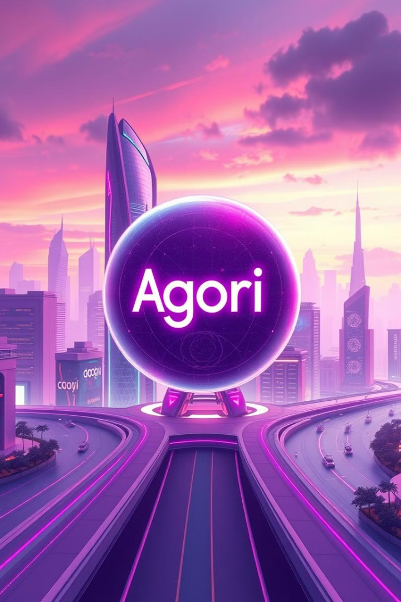
SecureTrade: Agori's Dapplication for the Future
SecureTrade is a cutting-edge dapplication built on the Agori platform. It's poised to transform the future of finance, offering secure and efficient trading experiences.
Vikas das 230301120326
Jagan parida 23030110327

Slide 2
Introducing Agori: Revolutionizing Secure Trading
Decentralized
Secure
Agori utilizes a decentralized network, ensuring trust and transparency.
Advanced cryptographic protocols safeguard your assets.

Slide 3

The Problem: Vulnerability in Traditional Finance
Centralized Control
Security Breaches
Centralized entities can introduce risks and biases.
Traditional systems are susceptible to hacks and data leaks.
Lack of Transparency
Hidden fees and opaque processes can lead to distrust.

Slide 4



Agori's Innovative Solution: Decentralized Trading
1
Blockchain Technology
Smart Contracts
2
Automated and secure trading agreements.
Decentralized Governance
3
Community-driven decision-making.

Slide 5
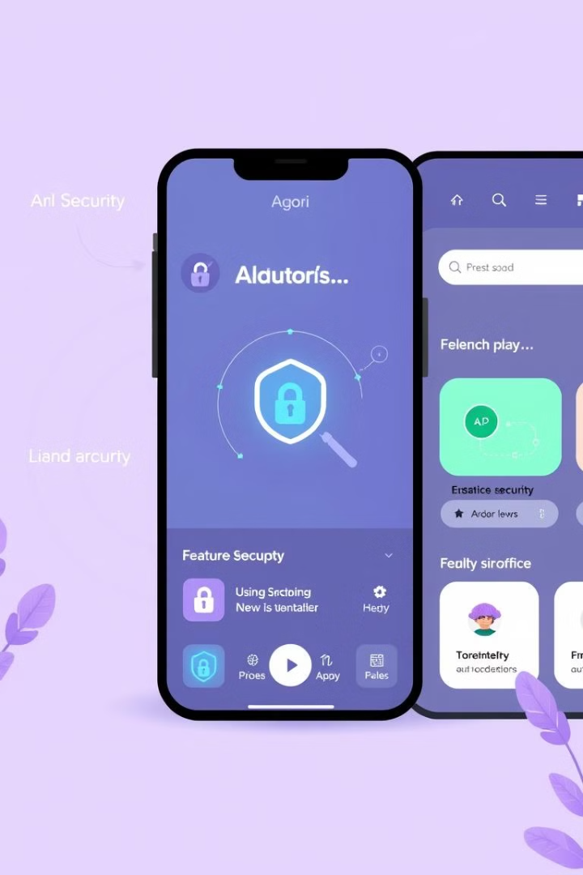



Key Features of the Agori Dapplication
Enhanced Security
Real-time Analytics
Multi-factor authentication and secure storage.
Track your investments and market trends.
Non-custodial Wallet
Control over your assets at all times.

Slide 6

Benefits of Secure Trading with Agori
Increased Transparency
Reduced Costs
All transactions are recorded on the blockchain, making them auditable and verifiable.
Lower trading fees and eliminated intermediaries save money.
Faster Transactions
Decentralized infrastructure enables quicker processing times.

Slide 7
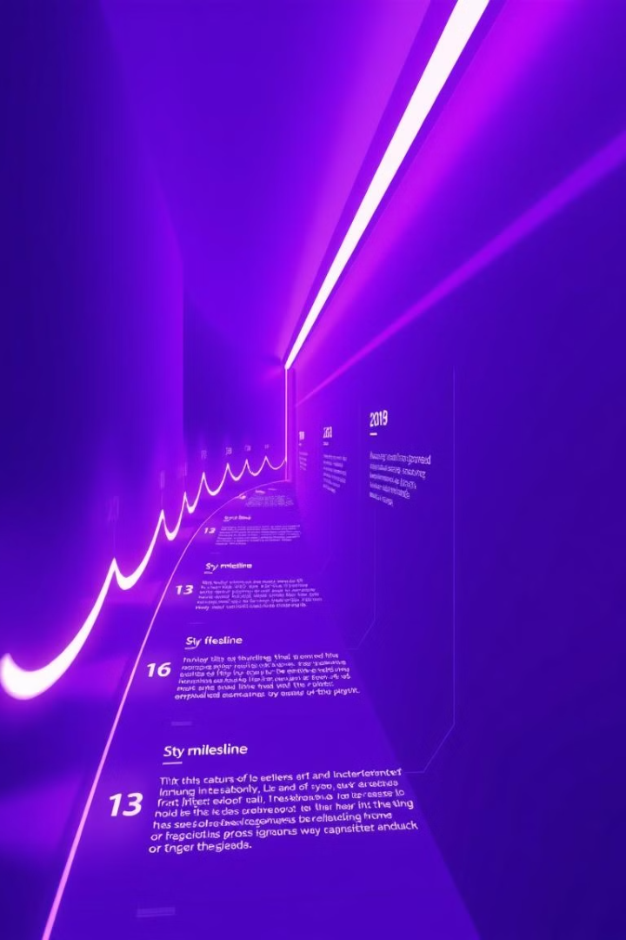
Roadmap and Future Developments
1
Phase 1: Core Platform
Launch of the core platform with key features.
2
Phase 2: Expansion of Asset Classes
Adding support for new asset classes, including NFTs and digital currencies.
3
Phase 3: Community Governance
Empowering users to participate in the decision-making process.

Slide 8

Conclusion: Embracing the Future of Finance
Agori's SecureTrade dapplication represents a significant step towards a more secure, efficient, and transparent financial future. By embracing this innovation, we can unlock new possibilities and empower ourselves in the evolving financial landscape.

